Slide 1

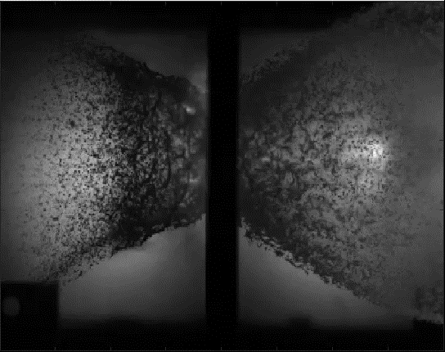
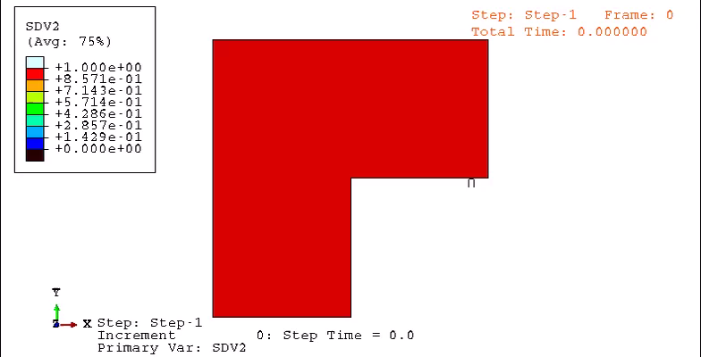







Materials for Extreme Environments
6.3 km/s HVI to 0.17 in Thick Carbon Composite Projectile: 4 mm Al 2017-T4 Sphere
4.8 km/s HVI to UHMWPE Projectile: 10 mm Al 1050 Sphere (HVIL-0017)
Hypervelocity Impacts
Advanced Diagnostics for Fragmentation Tracking
Multiscale Modeling - GraFEA

Slide 2







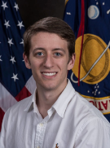






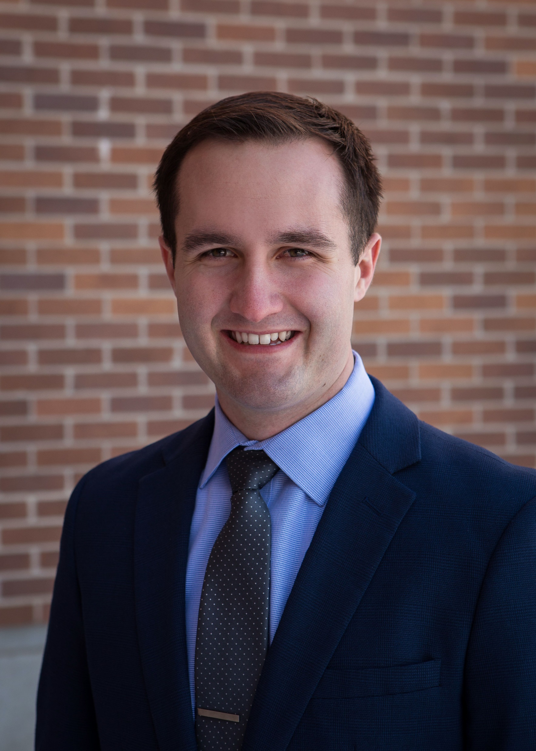
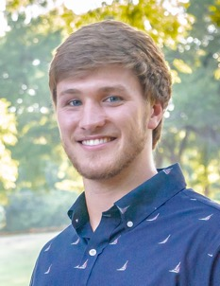

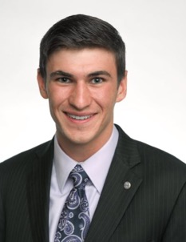
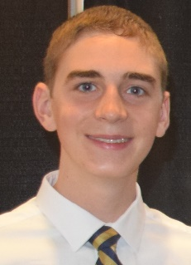
Materials for Extreme Environments Team
Dr. Thomas Lacy
Professor
telacyjr@tamu.edu
Dr. Raj Kota
BCDC Research Engineer
kkraj@tamu.edu
Dr. Waruna Kulatilaka
Associate Professor
waruna.kulatilaka@tamu.edu
Dr. J.N. Reddy
Distinguished Professor jnreddy@tamu.edu
Dr. Arun Srinivasa
Holdredge/Paul Professor arun.r.srinivasa@tamu.edu
Dr. Prakash Thamburaja
Visiting Professor prakash.thamburaja@tamu.edu
Dr. Justin Wilkerson
Assistant Professor
wilkerson@tamu.edu
Jacob Rogers NSF GRFP Fellow
Paul Mead DoD Smart Scholar
Khari Harrison
Gavin Lukasik
Aniket Mote
Carson Lawrence
Ho Yong Shin
Matthew Hay
BCDC Research Fellow
Joey Stricklin
James Leaverton
Nathaniel Bass
Cullen Miller

Slide 3
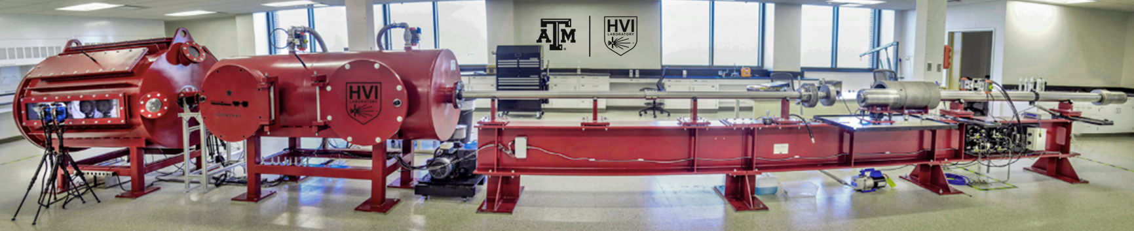


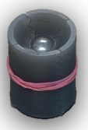
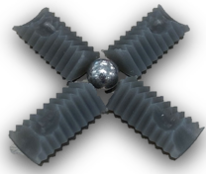

State-of-the-Art Dynamic Materials Testing & Characterization T.E. Lacy, K.R. Kota, W. Kulatilaka, J.N. Reddy, A. Srinivasa, J. Wilkerson
TAMU HVI laboratory provides a test bed for development and tailoring of novel structures comprised of advanced materials, including metals, composites, polymers, ceramics, and geomaterials
2SLGG*, High speed imaging (10M fps)*, laser based-diagnostics*, flash x-ray*, thermal imaging, photon Doppler velocimetry, etc.
Saboted Projectile
Projectile
Velocity: 2-8 km/s (4,400-18,000 mph)
Size: 2-10 mm (0.08-0.40 in)
Shape: cylindrical, spherical, ogive, buckshot
Target Specimen
Impact angle: 0-90°
Maximum size: 0.6 m x 0.6 m (2’ x 2’)
Maximum weight: ~90 kg (200 lb)
“Bear”
2SLG - Gun Dog
Future Plans: Establish suite of experimental capabilities (drop tower*, traditional Kolsky bar, miniature Kolsky bar*, flyer plate impact, and HVI testing*) that enable materials characterization over a wide range of strain rates (10²-10⁷). (*existing)
TAMU Laboratory for Nonequilibrium Phenomena: https://www.neplab.net/
TAMU Optical Diagnostics and Imaging Laboratory: https://laserlab.tamu.edu/

Slide 4
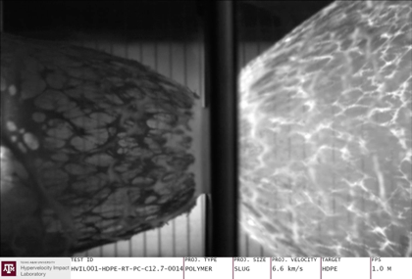
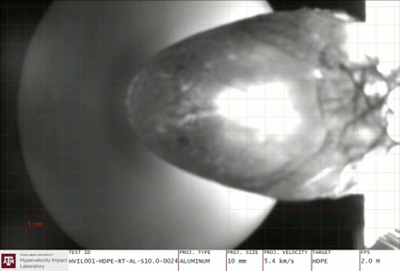
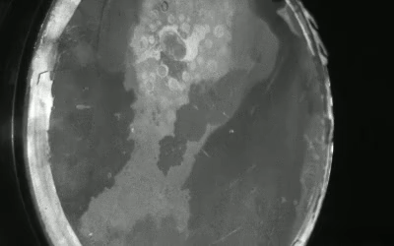
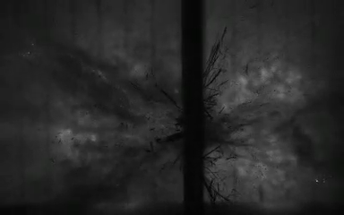
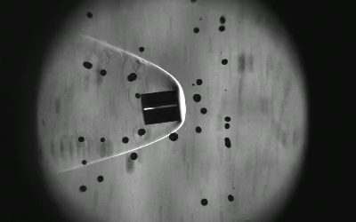
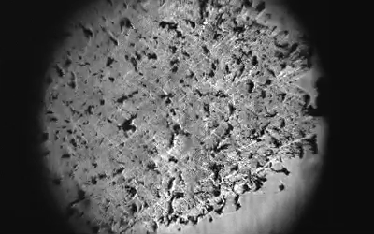
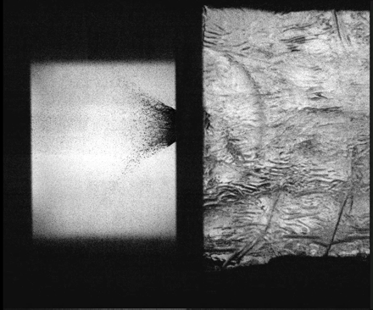
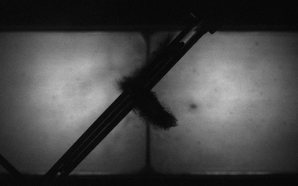
TAMU HVI Testing: A Perspective
Normal 6.6 km/s HVI to 6.35 mm Thick HDPE Projectile: 12.7 mm diameter Polymer Cylinder
60º 5.4 km/s HVI to 6.35 mm Thick HDPE Projectile: 10 mm diameter 1050 Al Sphere
Normal 2 km/s HVI to 3 in Thick High-Performance Concrete Projectile: 10 mm diameter S2 Steel Sphere
6.9 km/s HVI to 4 mm Thick Stitched Carbon/Epoxy Projectile: 6 mm diameter Al 2017-T4 Sphere
45°
2.5 km/s HVI to Water Droplets Projectile: 12.7 mm diameter PC Cylinder
Normal 2.6 km/s HVI to 6.35 mm Thick UHMWPE Projectile: 10 mm diameter 1050 Al Sphere
XXX km/s HVI to PC followed by ballistic gel Projectile: 4 mm diameter Al 2017-T4 Sphere
45º 2 km/s HVI to 4 mm Thick SiC Coated Carbon Composites Projectile: 4 mm diameter Nylon 6/6 Sphere

Slide 5
5/25 Meeting
record more data points (ongoing)
2 data points last week (both 4 mm @ ~ 6000 at 125 torr), very low variance by visual examination
may have trouble convincing anyone to let me use an even slightly risky backfill for their shot
optimization of tests for test matrix (completed)
will continue to procedurally update test matrix based on results
send all docs to jacob (done)
look up statistical methods and requirements (done)
model should hold up to review
edit thesis word doc and begin transfer to LaTeX (done)

Slide 6
6/8 Meeting
lit review (ongoing)
collected some articles to review, found some good info to cite for the statements I made in the paper
organized Mendeley
figures for paper
give feedback (done)
make changes (ongoing)

Slide 7
6/15 Meeting
examine paper content and determine which figures are appropriate
thesis content vs journal paper
think of a better term for sabot stripper
literature refers to it as sabot stripper/sabot stripper plate
opportunity to rename it something cool

Slide 8
Future/TODO
3D scan/measure 10/6/4 mm sabots to find center of mass for rotation arguments (TODO)
add in more analysis to the paper based on lit review / further investigation (TODO)

Slide 9
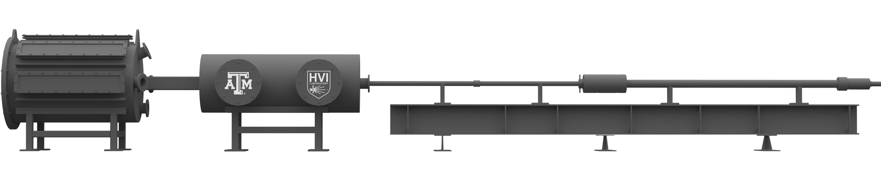
Figure 1
Figure 1: The two-stage light gas gun (2SLGG), with necessary dimensions, located in the TAMU HVI Laboratory. The key components of concern in this work are the muzzle, blast tank, and sabot stopping plate (SSP).
Downrange
Uprange
Target Tank
Sabot stopping plate
Blast Tank
Muzzle
Flight Tube
Central Breech
Powder Breech
Pump Tube
1.2 m
2.4 m
y
13.7 m
z

Slide 10
Table 1
Table 1: A summary of key properties for both the 4 mm and 10 mm sabots.
Property | 4 mm sabot | 10 mm sabot
Mass (g)
Density (g/cc)
Volume (cc)
Material?
L/D
Aerodynamic cutout radius (mm)
Number of serrations

Slide 11
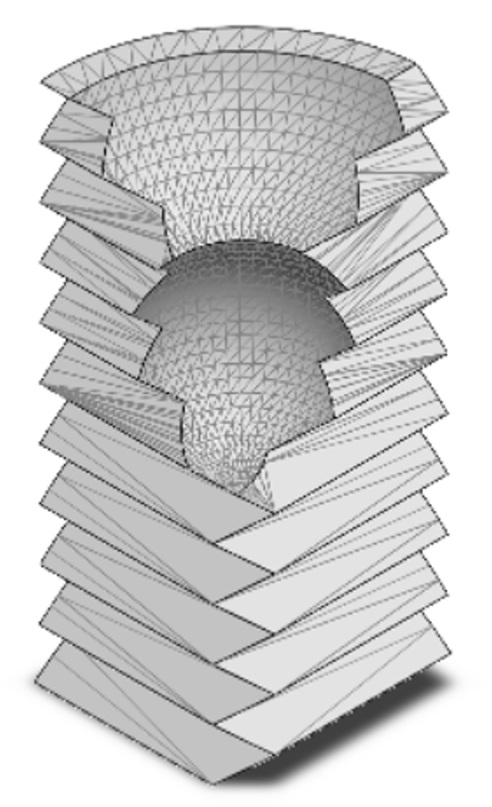
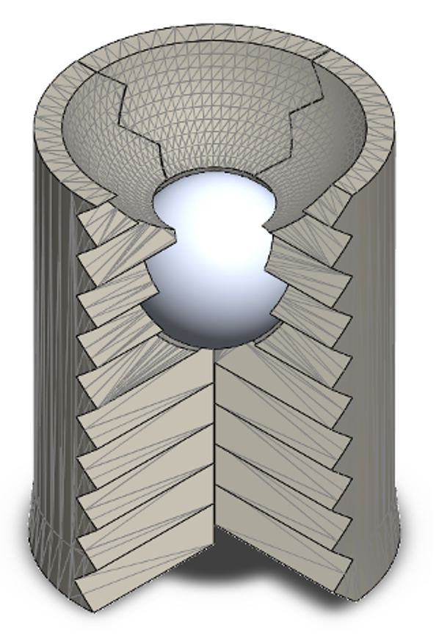
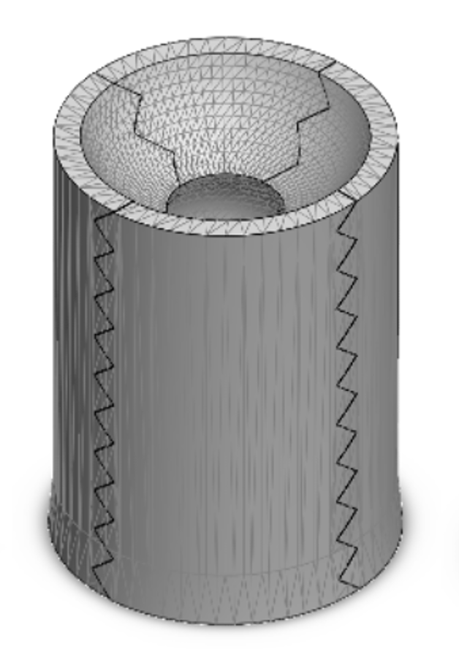
Figure 2
COMMENTS: can we replace these sabot figures with 4- and 10-mm sabot models? This will give the reader an idea of the relative size difference, as 6 mm is not even considered in the paper. Also, can you provide the figures as separate images? I will finish the figure with annotations. I omitted Figure 4 because the ideas can be combined into this figure.
Sabot Petal
Partially Closed Sabot
Fully Closed Sabot
4 mm projectile cavity
Aerodynamic cutout
⌀XX mm
4 mm
45º serration
XX mm
4 mm projectile
Figure 2: Three-dimensional models of the two considered sabot configurations with dimensions and key features: (a)-(c) 4 mm sabot and (d)-(f) 10 mm sabot.
(a)
(b)
(c)
12.7 mm
10 mm projectile cavity
Aerodynamic cutout
⌀XX mm
10 mm
45º serration
XX mm
10 mm projectile
(d)
(e)
(f)
12.7 mm

Slide 12
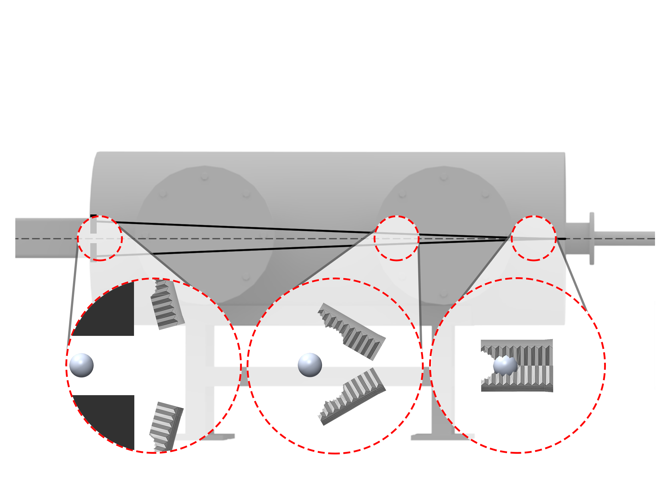
Figure 3
Downrange
Sabot stopping plate (SSP)
Uprange
Sabot flight path
Projectile flight path
Drift Tube
Blast Tank
Figure 3: The main sequence of events during aerodynamic sabot separation: (1) projectile package exits the 2SLGG launch tube muzzle, (2) sabot petals aerodynamically separate from the projectile, and (3) the sabot petals impact the sabot stopping plate (SSP) as the projectile enters drift tube. Only two sabot petals are shown for visualization purposes.
y
z
(3)
(2)
(1)

Slide 13
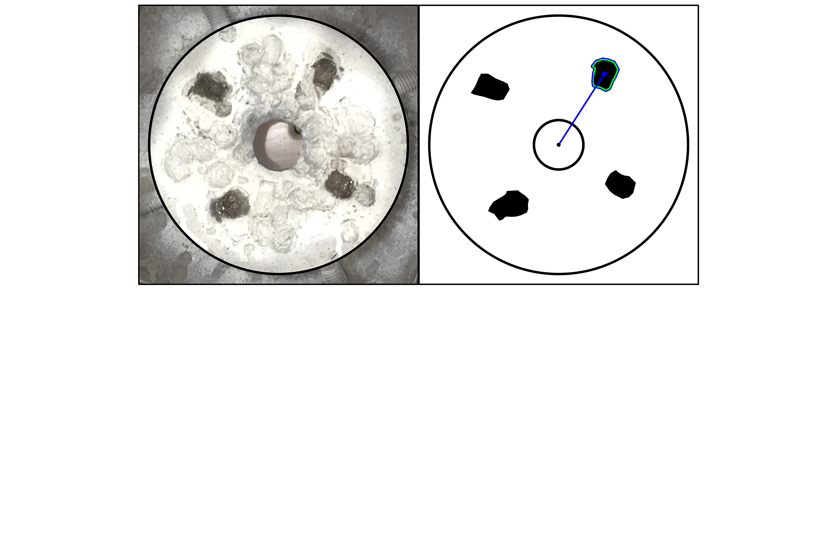
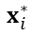
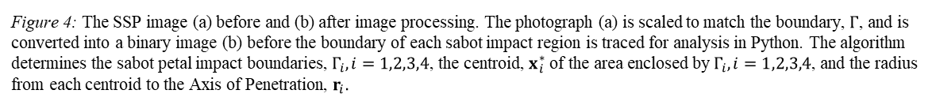
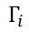
Figure 4
(a)
y
(b)
y
Sabot impact
x
$$x_{i}^{∗}$$
x
Figure 4: The SSP image (a) before and (b) after image processing. The photograph (a) is scaled to match the boundary, $Γ$, and is converted into a binary image (b) before the boundary of each sabot impact region is traced for analysis in Python. The algorithm determines the sabot petal impact boundaries, $Γ_{i}, i=1,2,3,4$, the centroid, $x_{i}^{∗}$ of the area enclosed by $Γ_{i},i=1,2,3,4$, and the radius from each centroid to the Axis of Penetration, $r_{i}.$
2
2
$$Γ_{i}$$
2
1
$$r_{i}$$
2
1
1
AoP
Ø31.8 mm
4
4
4
4
3
3
Ø152.4 mm
Photograph
$$Γ$$
Binary Image
$$Γ$$

Slide 14
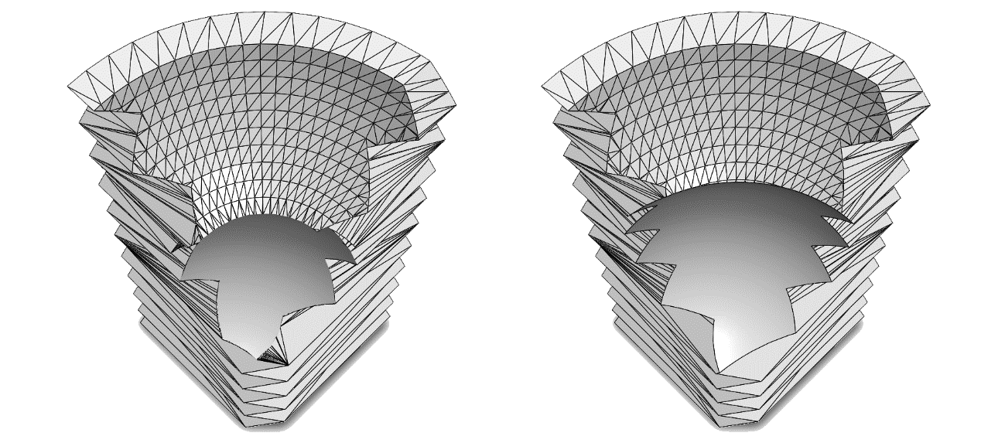
Figure 4
Necessary to show difference in downrange end of 10/4 mm sabot. This can be combined/reconfigured to show the center of mass to demonstrate the moment of inertia
Identify the different aspects. Make sure this figure is necessary and can stand alone. What is it in this figure that makes it necessary? Why not just use Fig. 2?

Slide 15
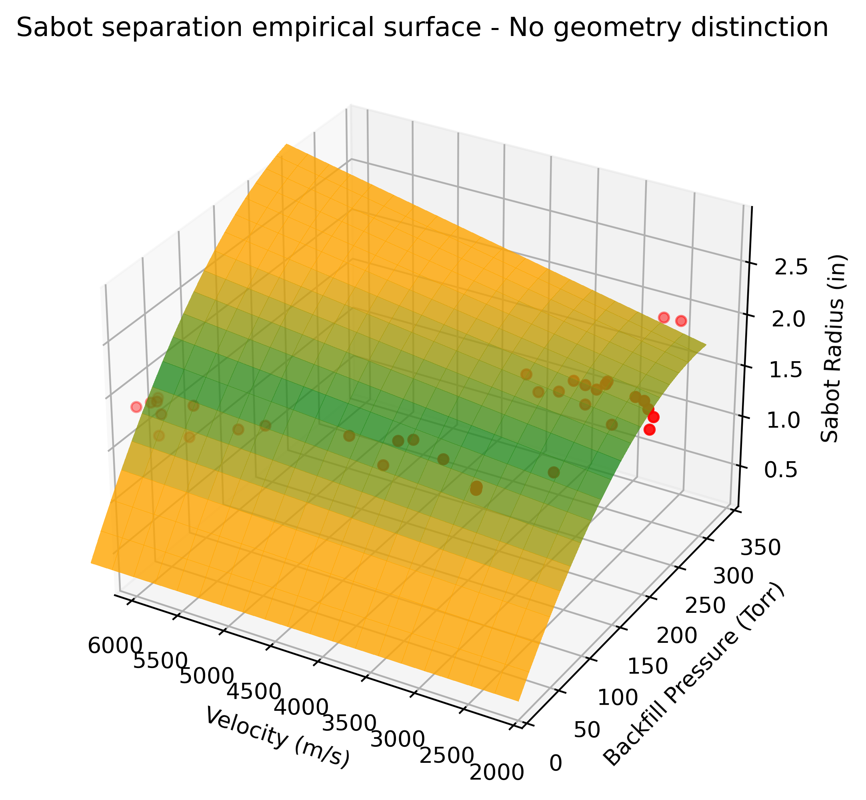
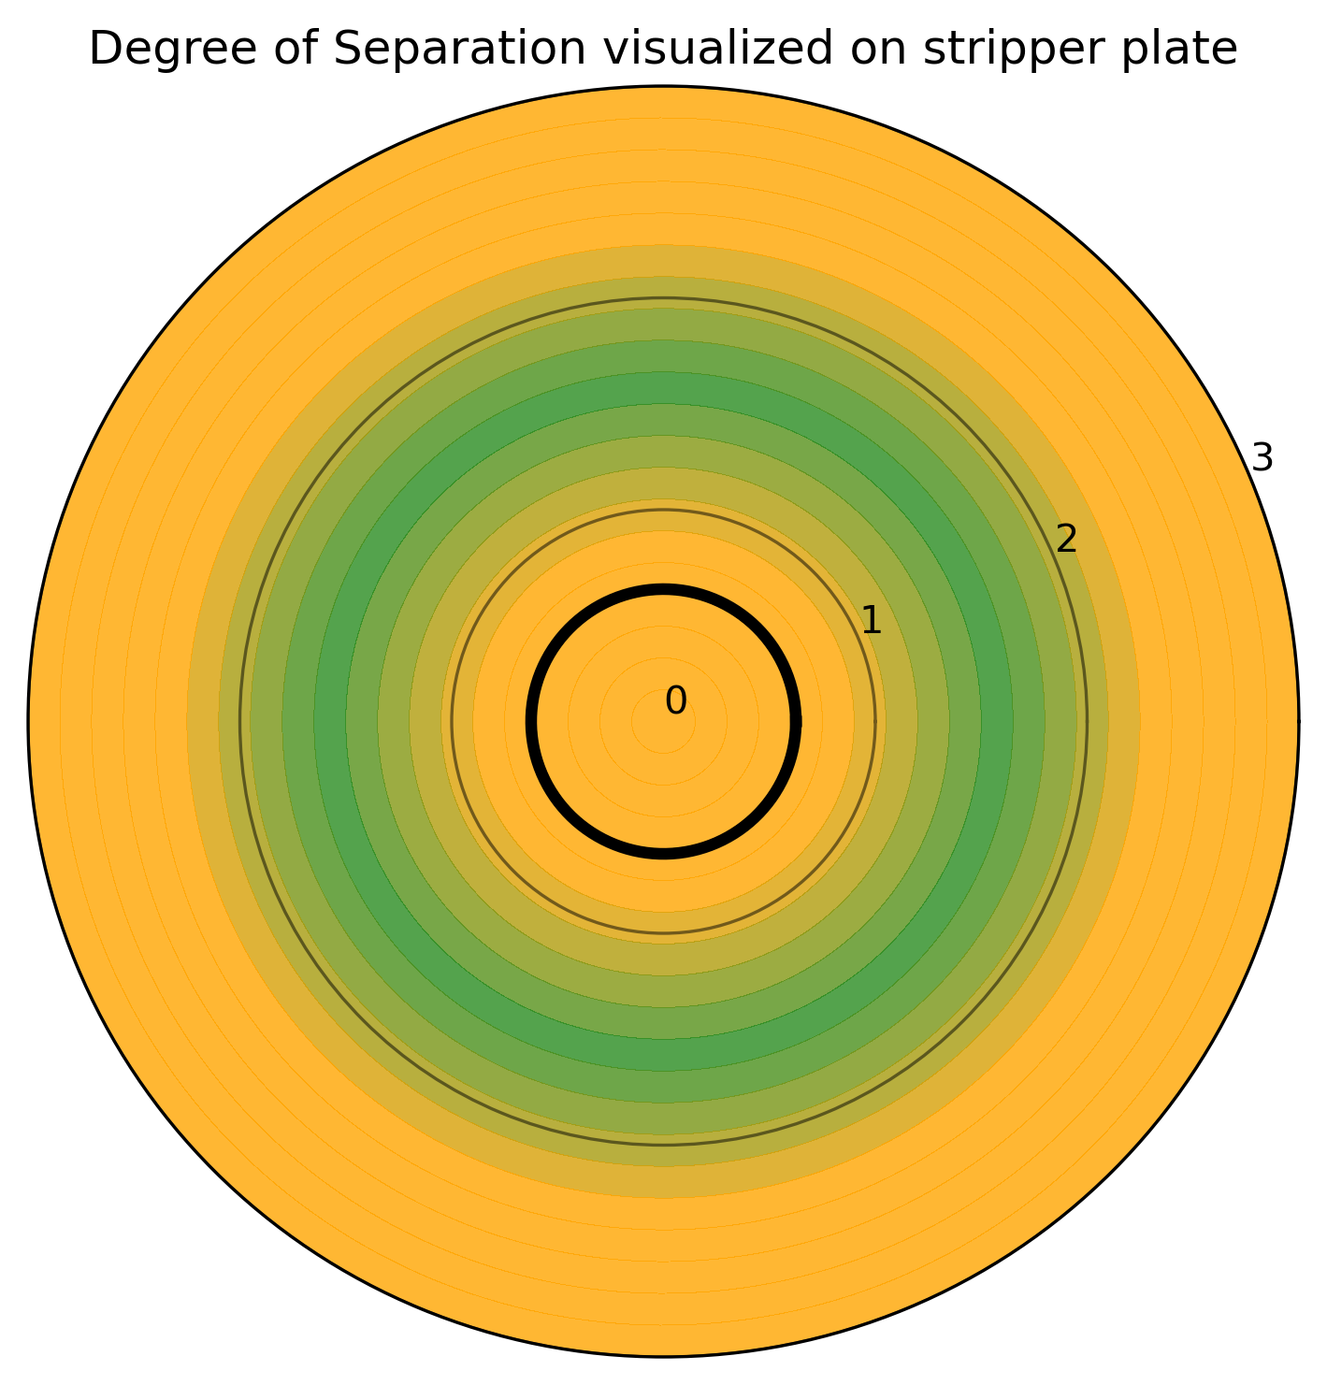
Figure 4
(a)
(b)
I like figure (b), but you may want to add notes/text to indicate what the different regions mean to the reader. Also, you need to indicate that it is a sabot stripping plate. For figure (a), we need to convert from m/s to km/s, and from inches to mm. We want a white background and make the view isometric. I would also fix the gridlines so they evenly spaced. Essentially, clean up the axes.

Slide 16
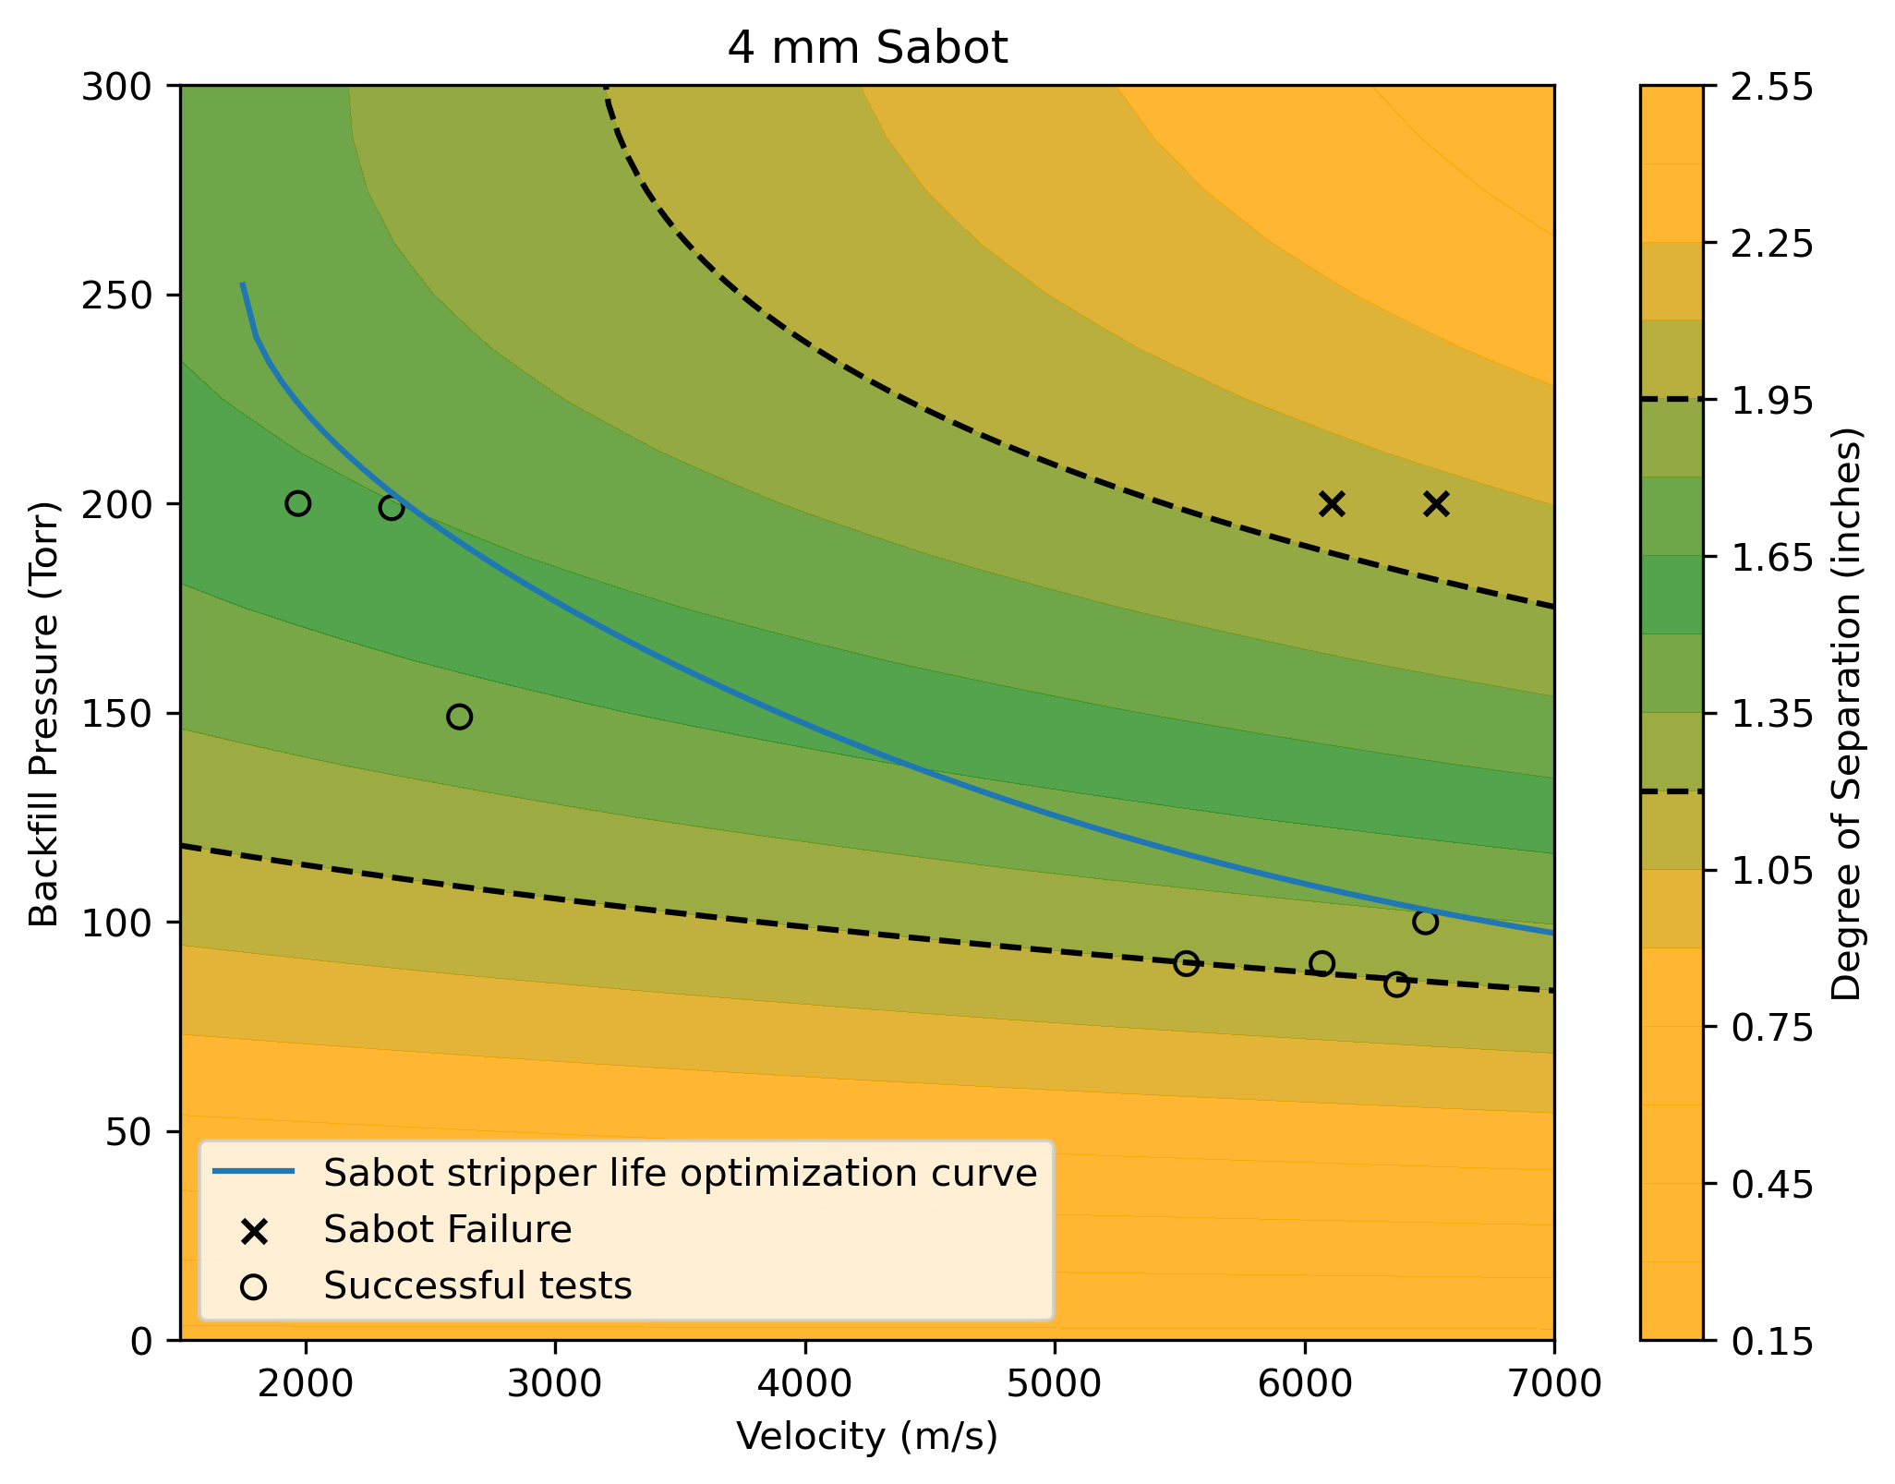
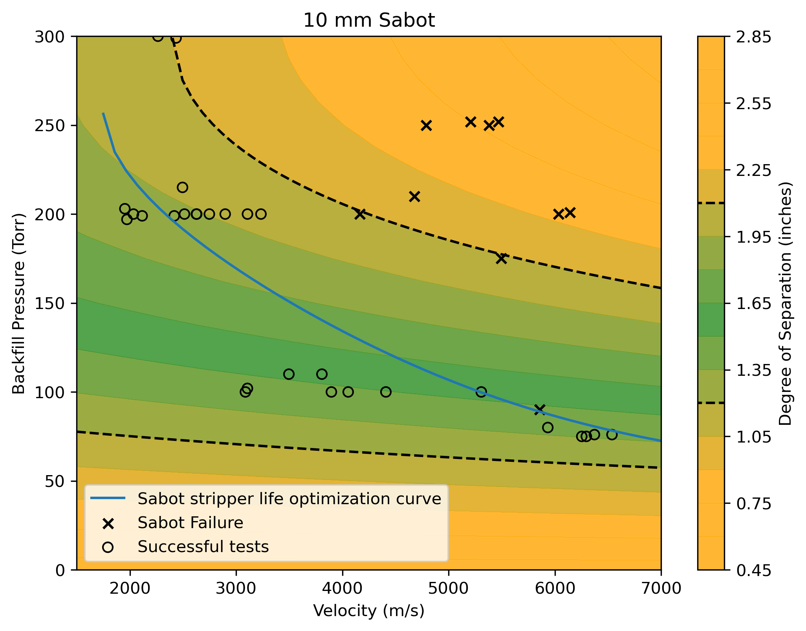
Figure 5
Change from m/s to km/s and from inches to mm.

Slide 17
"There is nothing more fulfilling than to serve your country and your fellow citizens and to do it well.” – Pres. George H.W. Bush
Contact Information: Director Manager
Dr. Tom Lacy, MEEN Dr. Raj Kota, BCDC
TELacyJr@TAMU.edu KKRaj@TAMU.edu
(662) 948-9213 (cell) (662) 617-9196 (cell)

